Slide 1
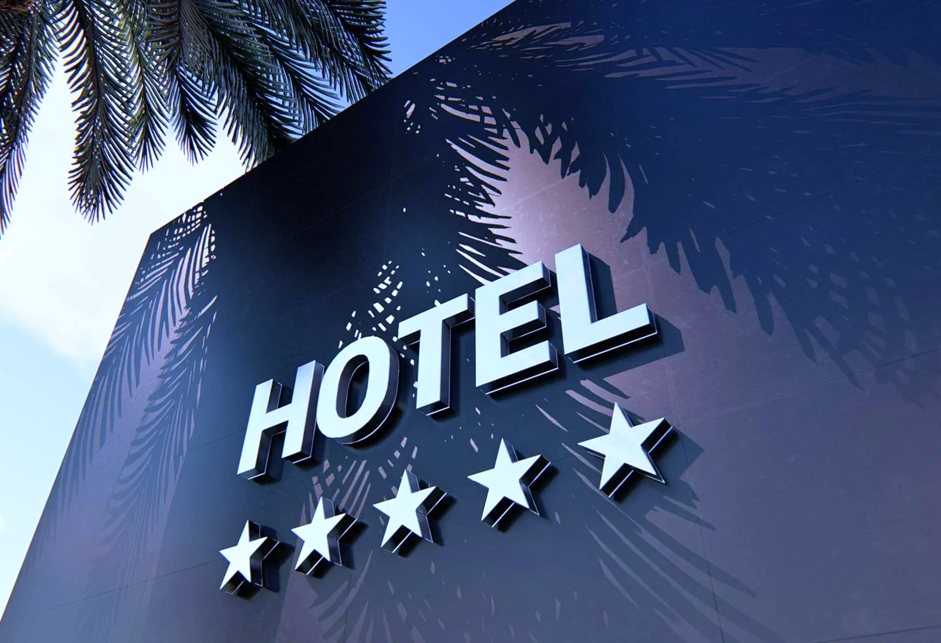
Hotel Booking Cancellation Prediction
Analysis of 5 Machine Learning Algorithms with Optimized Feature Engineering
Wong Wing Yin , Renee

Slide 2
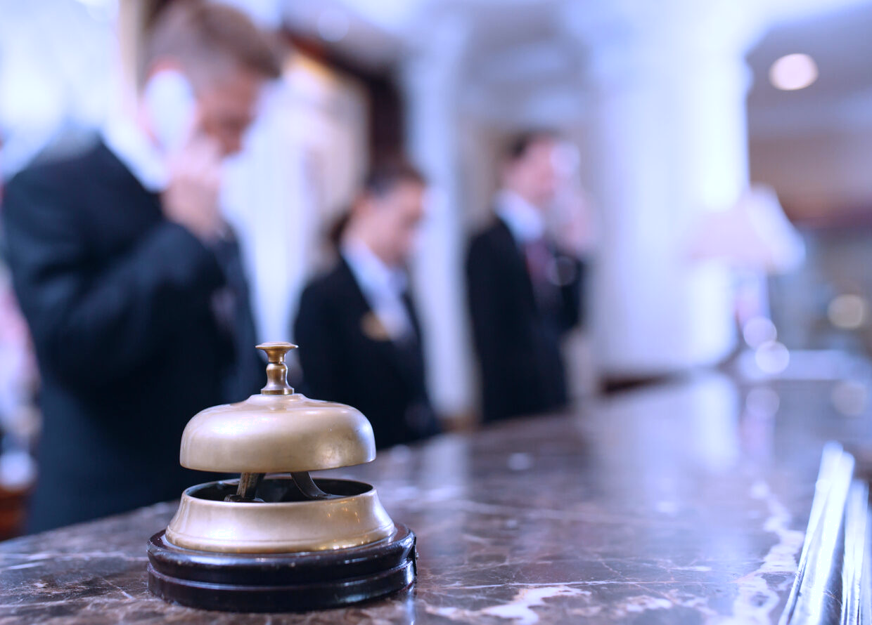
Project Objectives
01
02
03
Identify Predictive Features
Compare ML Algorithms
Optimize Feature Engineering
Determine the most important factors that signal potential cancellations across booking patterns
Evaluate performance of 5 different machine learning approaches to find optimal prediction method
Leverage automated techniques to enhance predictive power through transformation optimization
04
05
Analyze Property Patterns
Deliver Business Insights
Understand differences between Resort and City hotel cancellation behaviors
Provide actionable recommendations for deployment and revenue optimization

Slide 3


The Billion-Dollar Challenge
Cost of Cancellations
Strategic Opportunity
average cancel rates hovering around 24% within the industry
Early prediction enables proactive strategies
Lost Revenue
Dynamic pricing adjustments
Operational Waste and Inefficient Resource Allocation
Targeted policies
Enhanced staffing and inventory planning
Increased Overbooking Risk
Negative brand image

Slide 4



Dataset Overview
32 columns
Comprehensive booking attributes
119,390
20 internal and booking data
hotel reservations
Lead time, deposit, days_in_waiting_list
Across 3 years(2015-2017)
11 customer and market data
country, market segment, customer_type
178
Countries
Global guest origin diversity
Target variable :is_canceled = 0/1
66.4%
33.6%
37%
City Hotels
Resort Hotels
Cancellation Rate

Slide 5
Data Processing
Data transformation
Fill in all the missing
Transform raw data into informative data
Children(KNN Imputer)
Country(mode)
Agent(0)
1
Putting year, month, day into one column
Arrival season
3
One-Hot Encoding and Label Encoding
Categorical to bool/int/float
Peak tourist season
3
'meal', 'market_segment', 'hotel', 'distribution_channel', 'deposit_type', and 'customer_type’. reserved_room_type
2
Holiday period in the destination
Divide countries into regions
Dropping unnecessary column
Dropping unnecessary columns to enhance model speed, avoid data leakage, and prevent overfitting
4
Holiday period in the country of origin
reservation_status
Downgrade, upgrade, or unchanged

Slide 6
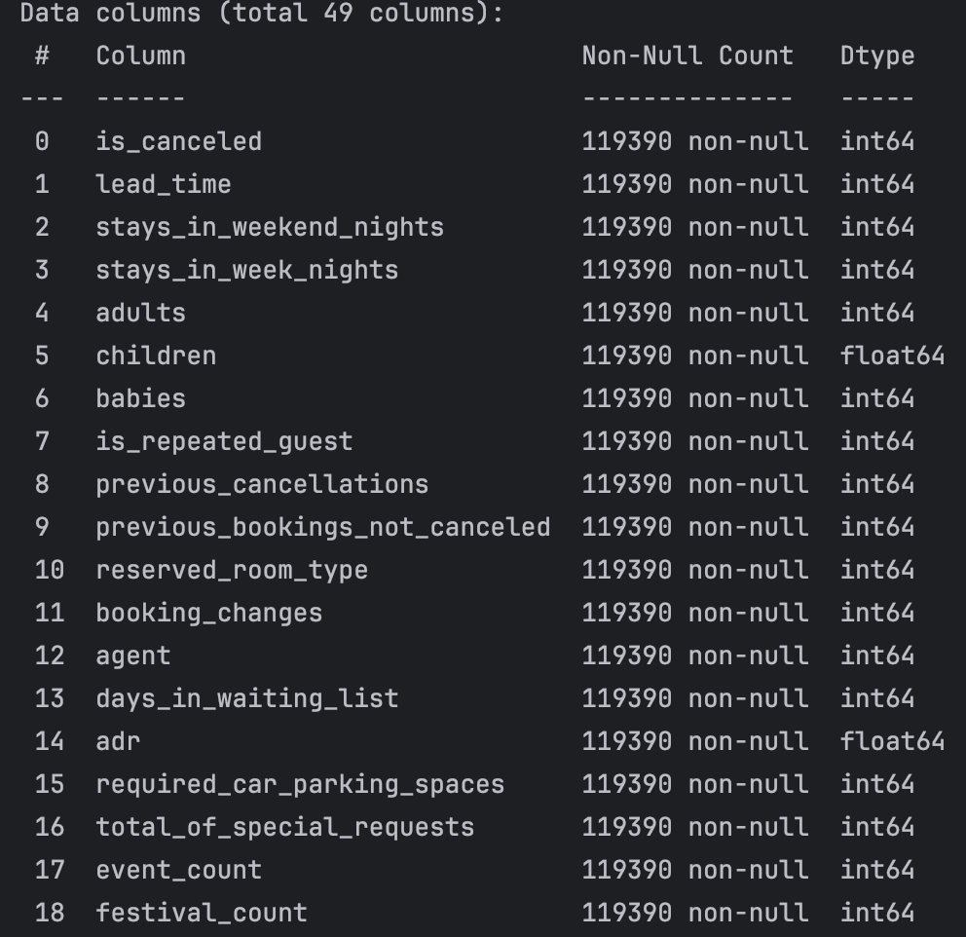
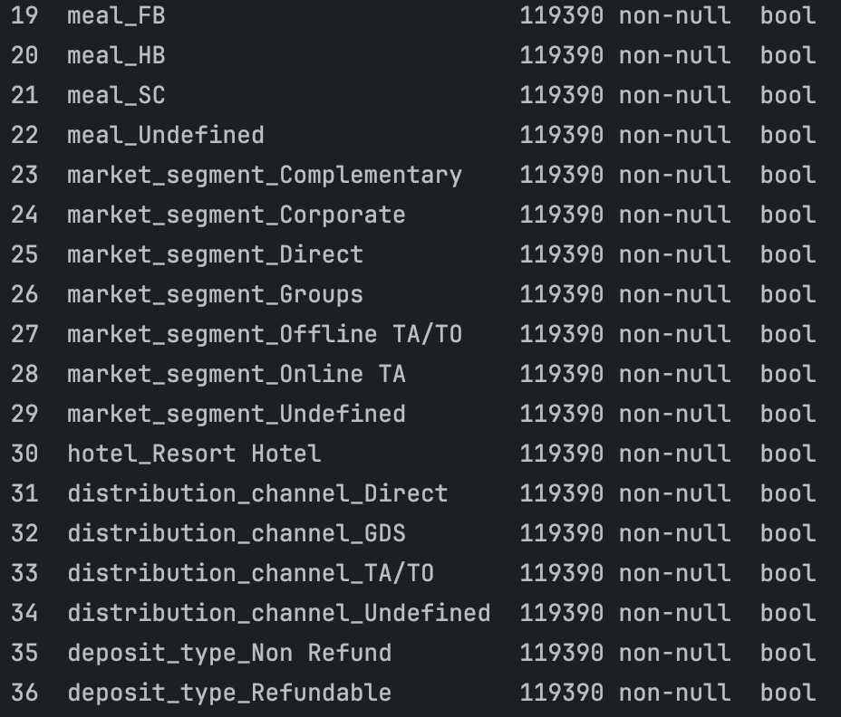
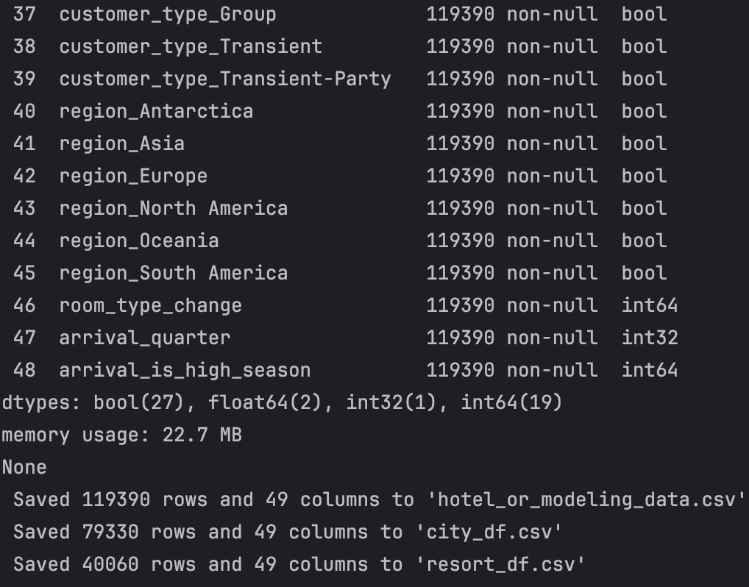



Modeling
Hotel_or_modeling_data.csv
48
Booking data for all types of hotels, including city hotels and resort hotels. It provides the most comprehensive
perspective, allowing for analysis of overall hotel booking trends and patterns.
Features
City_df.csv
Resort_df.csv
In-depth analysis of city hotel booking trends and
patterns
In-depth analysis of resort hotel booking trends and
patterns

Slide 7
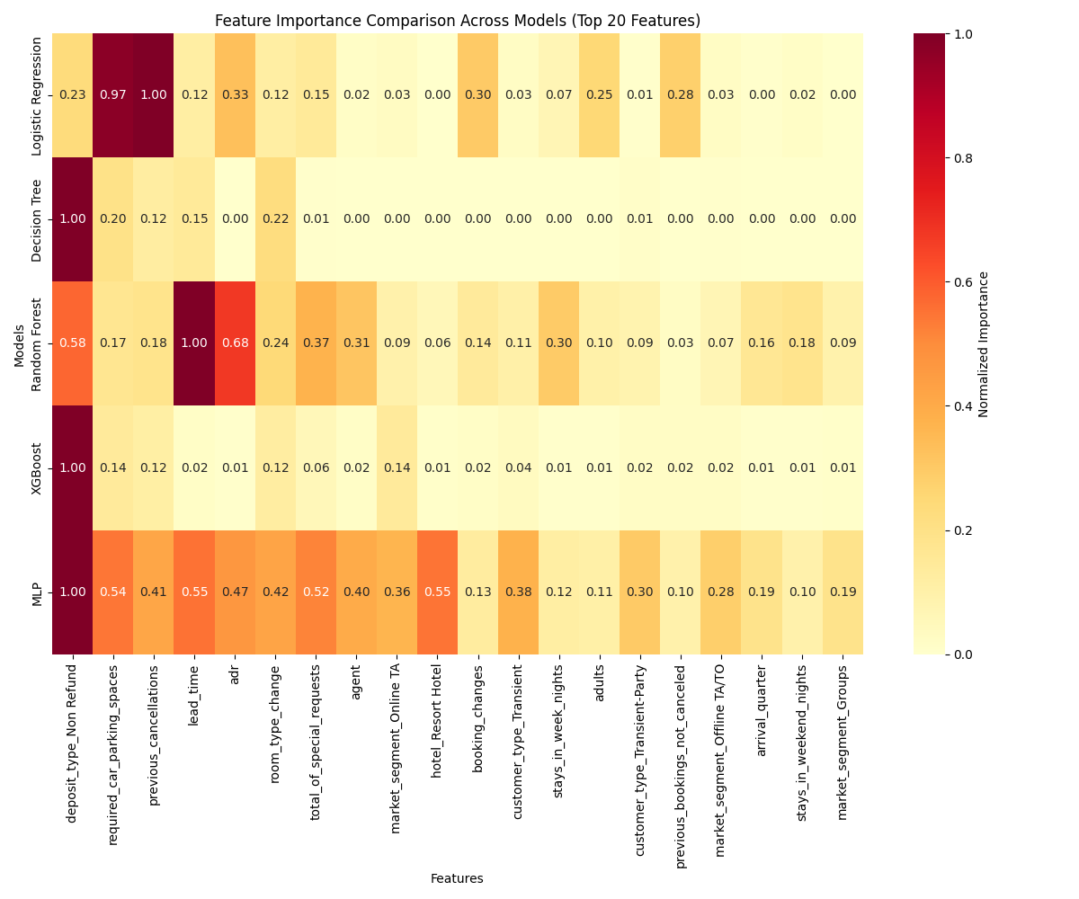
Overall Model Performance
Model | accuracy | f1 | AUC
Random Forest | 0.88 | 0.83 | 0.94
XGBoost | 0.85 | 0.80 | 0.92
MLP | 0.84 | 0.77 | 0.91
Logistic Regression | 0.79 | 0.72 | 0.86
Decision Tree | 0.77 | 0.55 | 0.80
Stacking(LR+XGB) | 0.84 | 0.79 | 0.92
Best model: Random Forest
Best method: Ensemble Methods
The top 3 models are all ensemble methods:
1. Random Forest (bagging)
2. XGBoost (boosting)
3. Stacking (LR + XGBoost)
Combining multiple decision boundaries is crucial for this problem.
Notes:
Random Forest：使用 Bagging 方法，將多個決策樹的預測結果平均或投票來形成最終預測結果。
XGBoost：使用 Boosting 方法，將多個決策樹的預測結果累加起來形成最終預測結果。

Slide 8







Engineering Features optimization with Optuna
Engineered Features Tested
100 testes
price_per_night_per_guest
1
adr/ adults+children+babies
2
high_price_peak
ADR × high season indicator
lead_time_squared
3
4
children_squared
Booking_stability_score
5
previous_bookings_not_canceled /
(previous_bookings_not_canceled'+ 'previous_cancellations+1)
6
weekend_ratio
stays_in_weekend_nights / (stays_in_weekend_nights + stays_in_week_nights + 1),

Slide 9
Optuna Optimization Results
price_per_night_per_guest
weekend_ratio
Transformation: NONE
Transformation: square
lead_time_squared
children_squared
Transformation: NONE
Transformation: NONE
booking_stability_score
Transformation: NONE
Model | accuracy | f1 | AUC
Random Forest | 0.87 | 0.82 | 0.94
XGBoost | 0.85 | 0.80 | 0.93
MLP | 0.84 | 0.78 | 0.92
Logistic Regression | 0.79 | 0.72 | 0.87
Decision Tree | 0.76 | 0.55 | 0.79
Only a small AUC lift + accuracy down
The original feature set already provides strong predictive power
Addiction features may lead to unnecessary complexity and potential overfitting
Keep the current feature set for the best balance of performance and simplicity

Slide 10
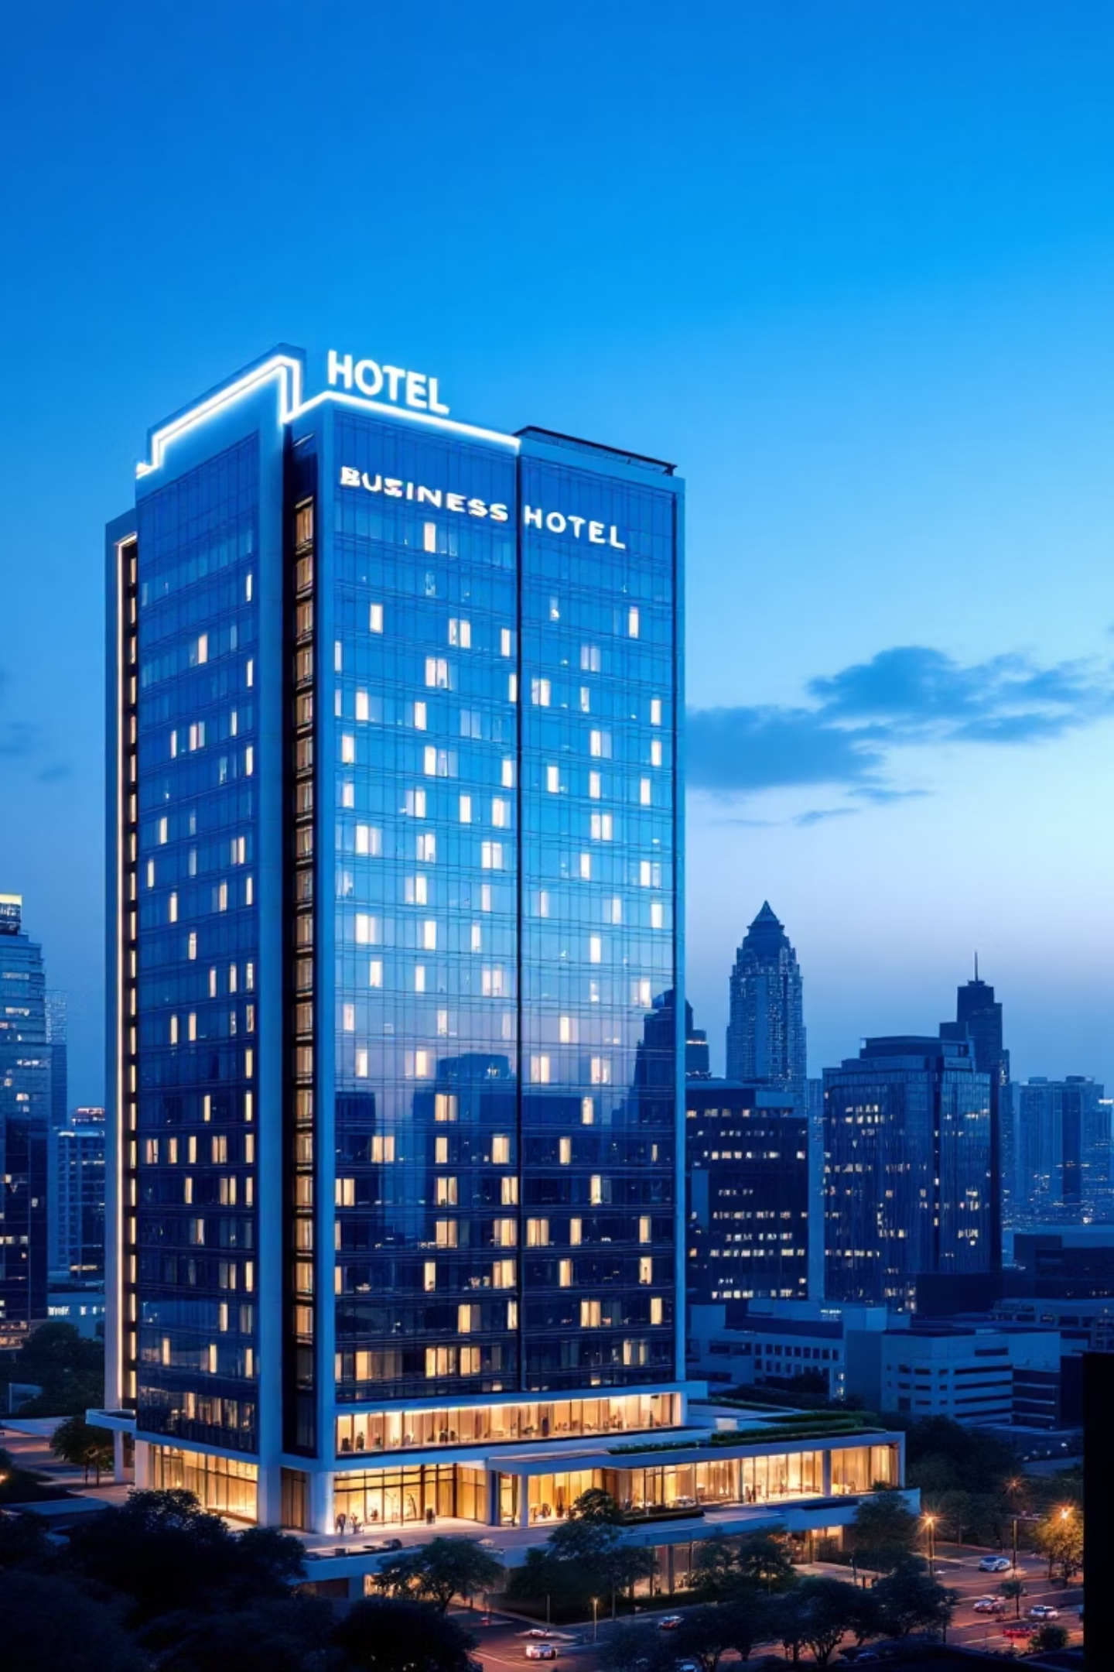
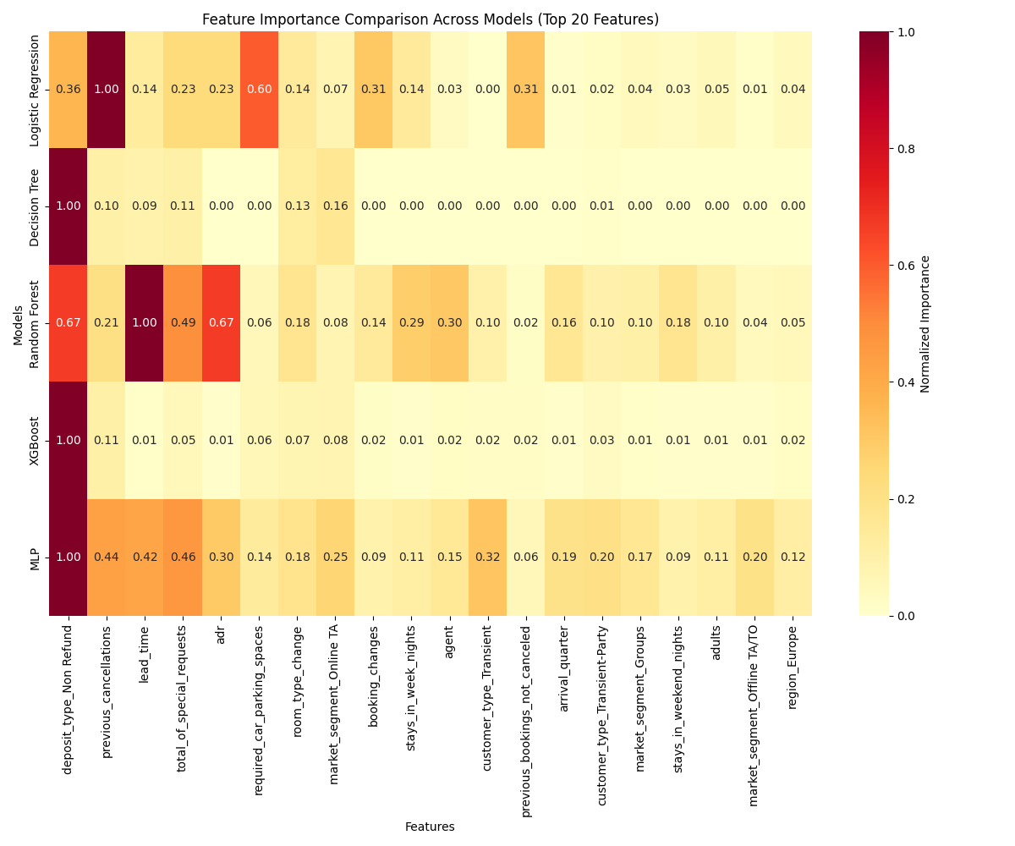
City Hotels: Higher Cancellation Challenge
41.7%
87.05%
93.86%
Cancellation Rate
Best accuracy (Random
Forest)
Best AUC (Random Forest)
Top 4 Predictors
adr
deposit_type_Non Refund
previous_cancellations
lead_time

Slide 11
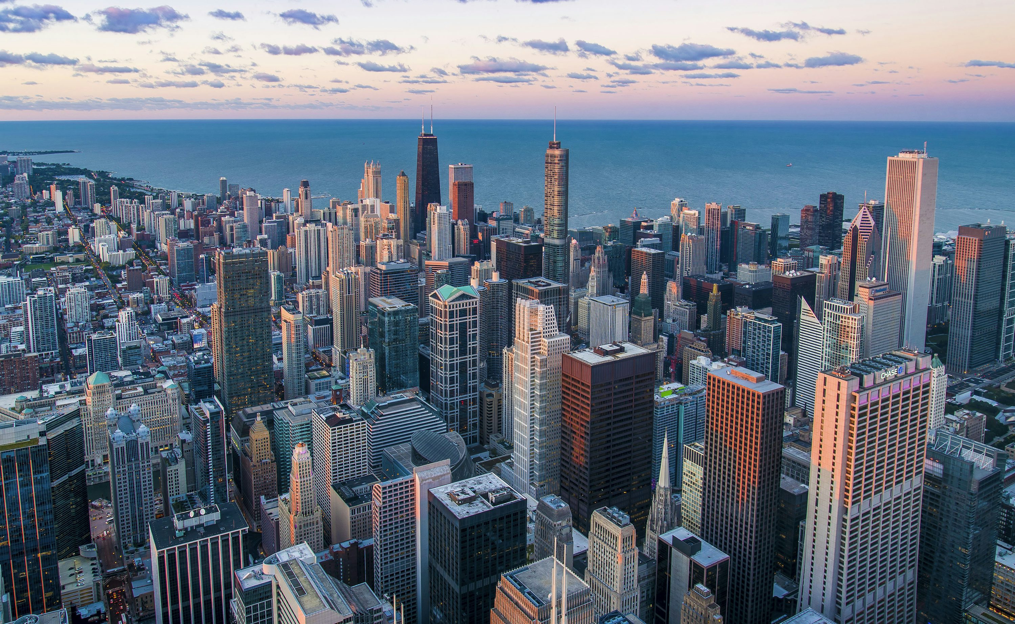
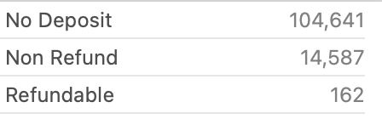
Key Findings
Target customer: short-trip traveler, business traveler
Price
Policy
Behavior
Time
Price sensitive
Non-refundable deposit
Previous cancellations
booking stability
City hotel guests are very responsive to room rates; even small price changes can impact cancellation likelihood.
less likely to cancel if the booking requires a non-refundable deposit, reflecting a stronger commitment
Guests with a history of cancellations are more prone to cancel again
Longer lead time leads to higher cancellation rate

Slide 12
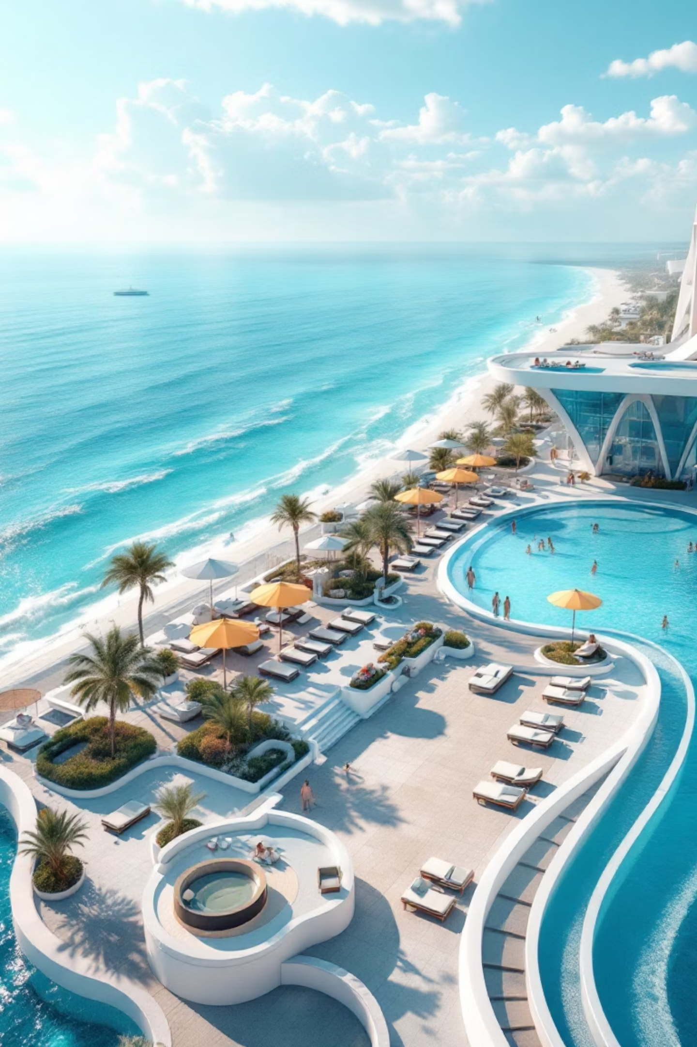
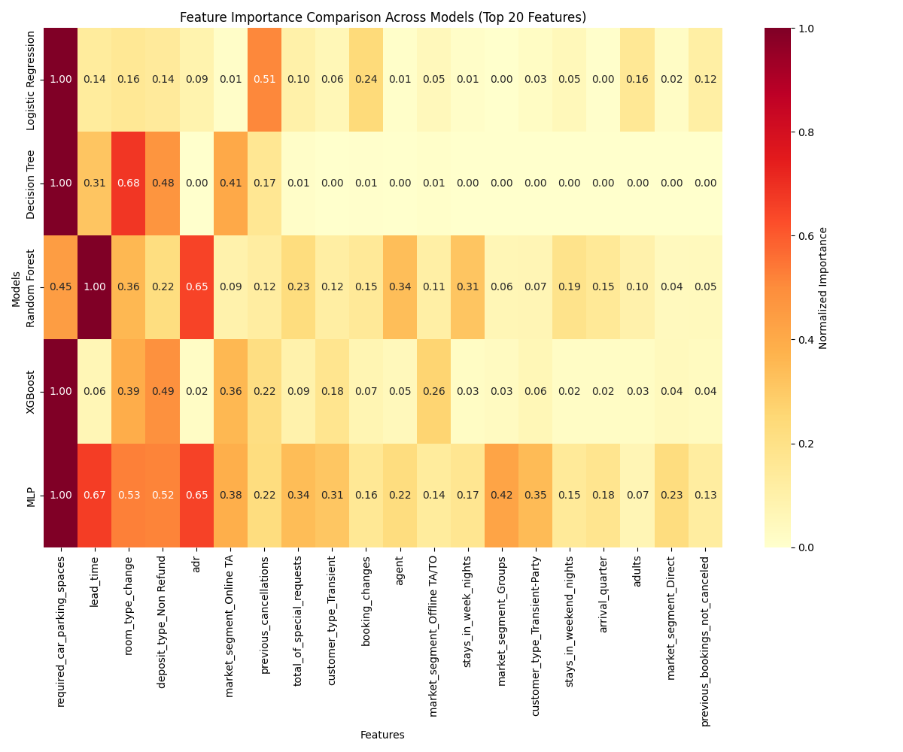
Resort Hotels: Lower Cancellation Baseline
36.05%
87.48%
95.96%
Cancellation Rate
Best accuracy (Random
Forest)
Best AUC (Random Forest)
Top 4 Predictors
total_of_special_requests
deposit_type_Non Refund
room_type_change
required_car_parking_spaces

Slide 13
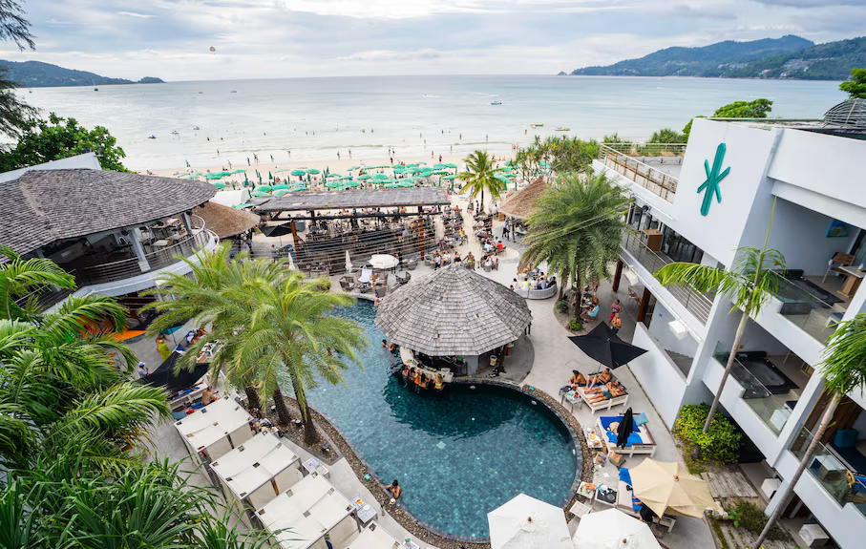
Key Findings
Target customer: families, couples, luxury travelers
Request
Room
Policy
Parking
Special requirements
Room type
Non-refundable deposit
car parking spaces
Resort hotel guests are planning for a specific experience, but unmet needs trigger cancellations
Guests expecting a certain room or upgrade
less likely to cancel if the booking requires a non-refundable deposit, reflecting a stronger commitment
Guests who request parking usually have already arranged their trips, reflecting a stronger commitment

Slide 14

Suggestion
City Hotel
Resort hotel
Sign corporate accommodation contracts
with flexible cancellation periods & fixed
pricing
Tailor experiences to individual guest
preferences to increase satisfaction
and reduce cancellations.
Auto-detect guests’ cancellation history, apply non-refundable deposits for high-risk guests
Implement a loyalty program to foster
emotional connection and encourage
repeat bookings
Launch a dedicated “Late Night Deals” category in the hotel app, offering discounts on unsold rooms for the same night to attract last-minute guests.
Bundle accommodation with car rental to boost booking commitment and convenience.

Slide 15

Thank you!

